Slide 1

The Balena IoT Ecosystem

Slide 2
A Quick Tour

Slide 3
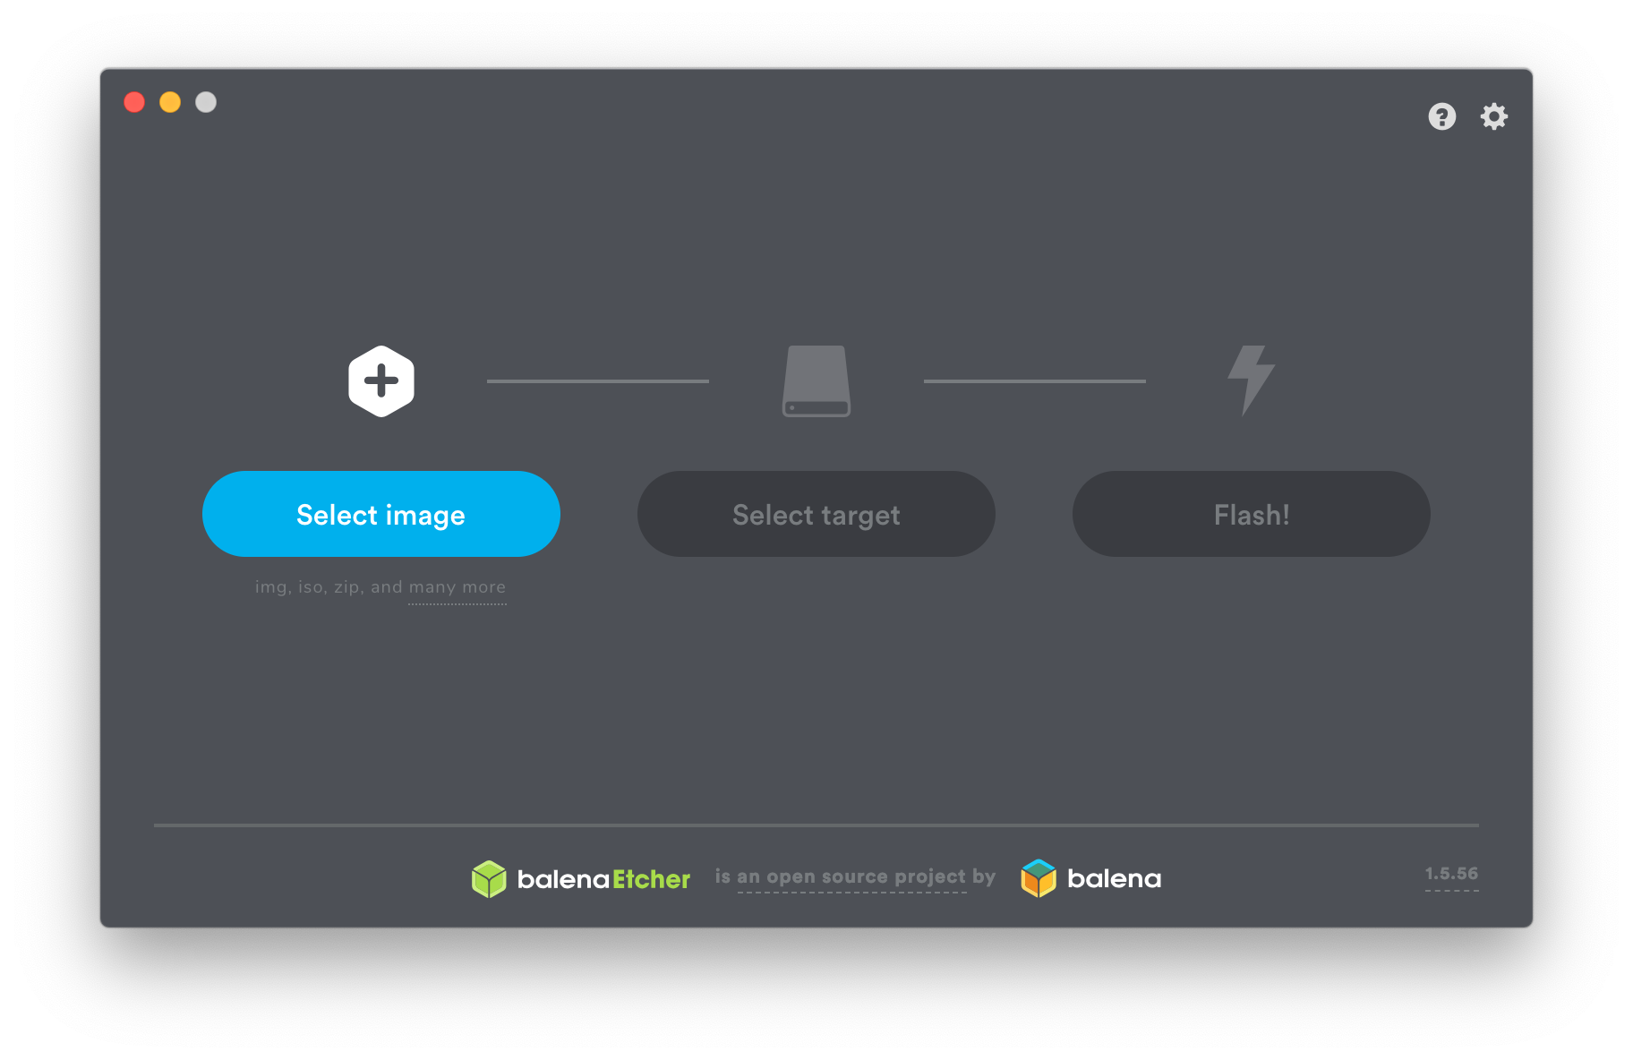
Notes:
I suspect there are some Etcher users in the audience.

Slide 4
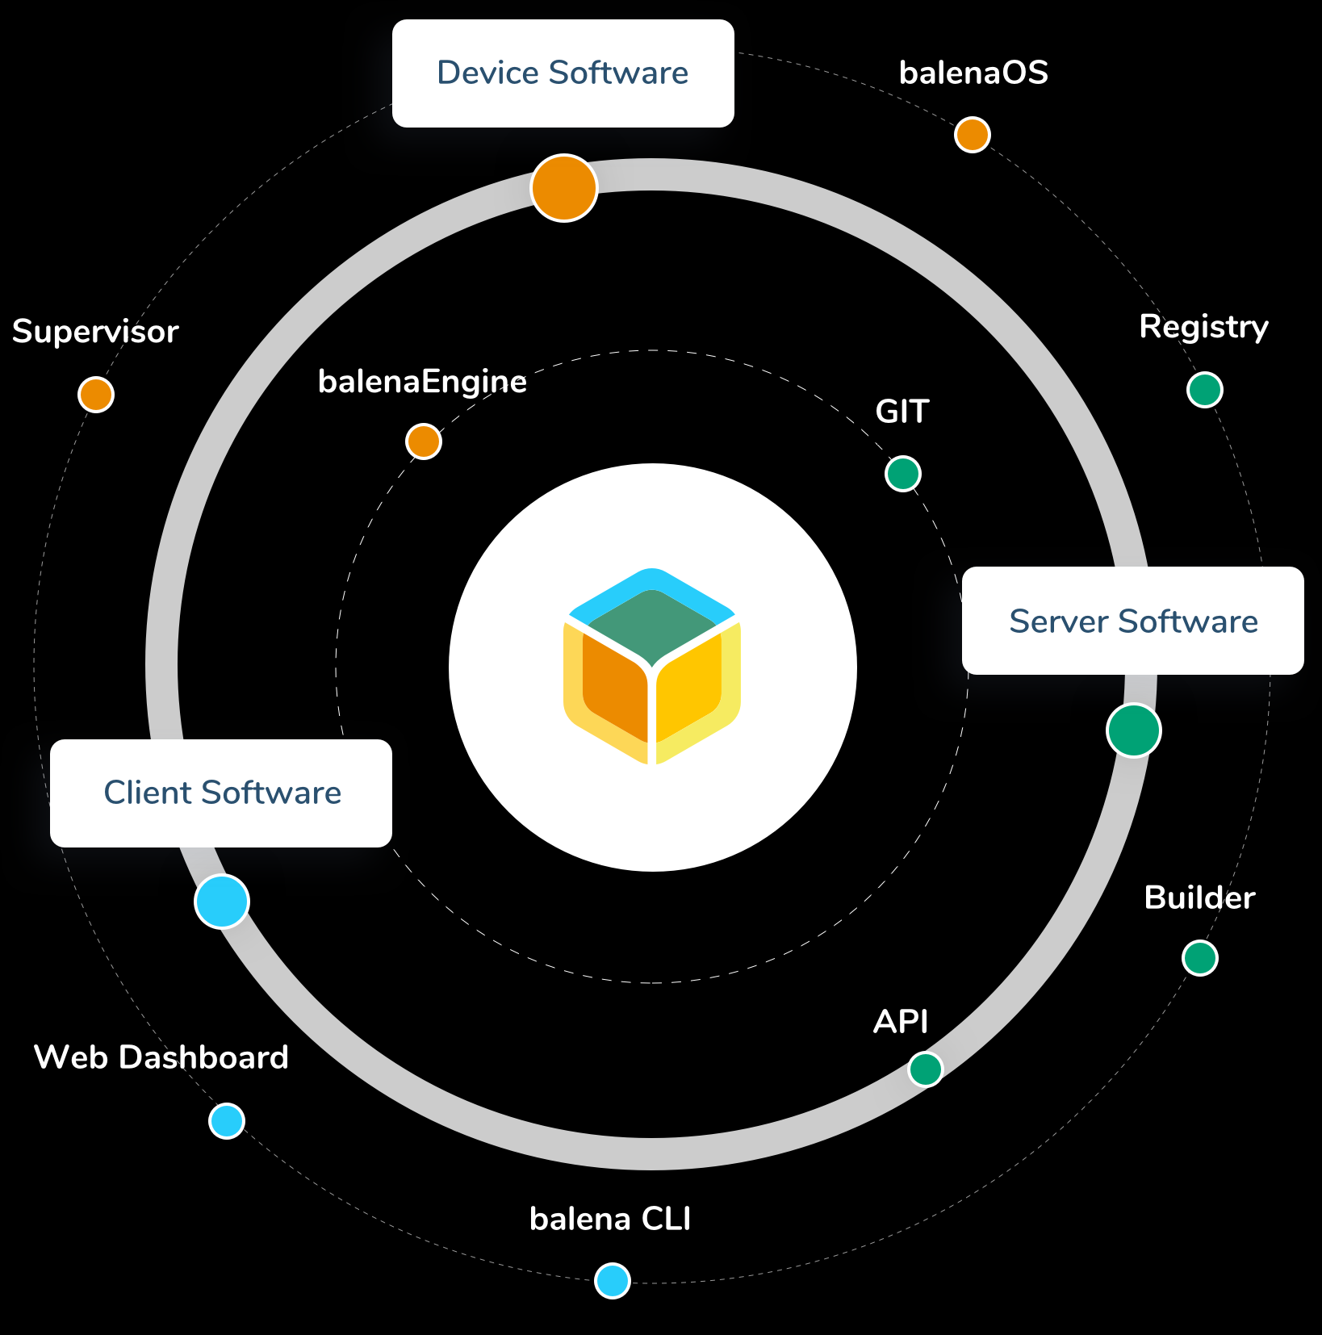
The Balena Ecosystem is Much More...
balenaCloud
balenaHub
balenaFin
EtcherPro
openBalena
balenaEngine
balenaOS
balenaLabs

Slide 5
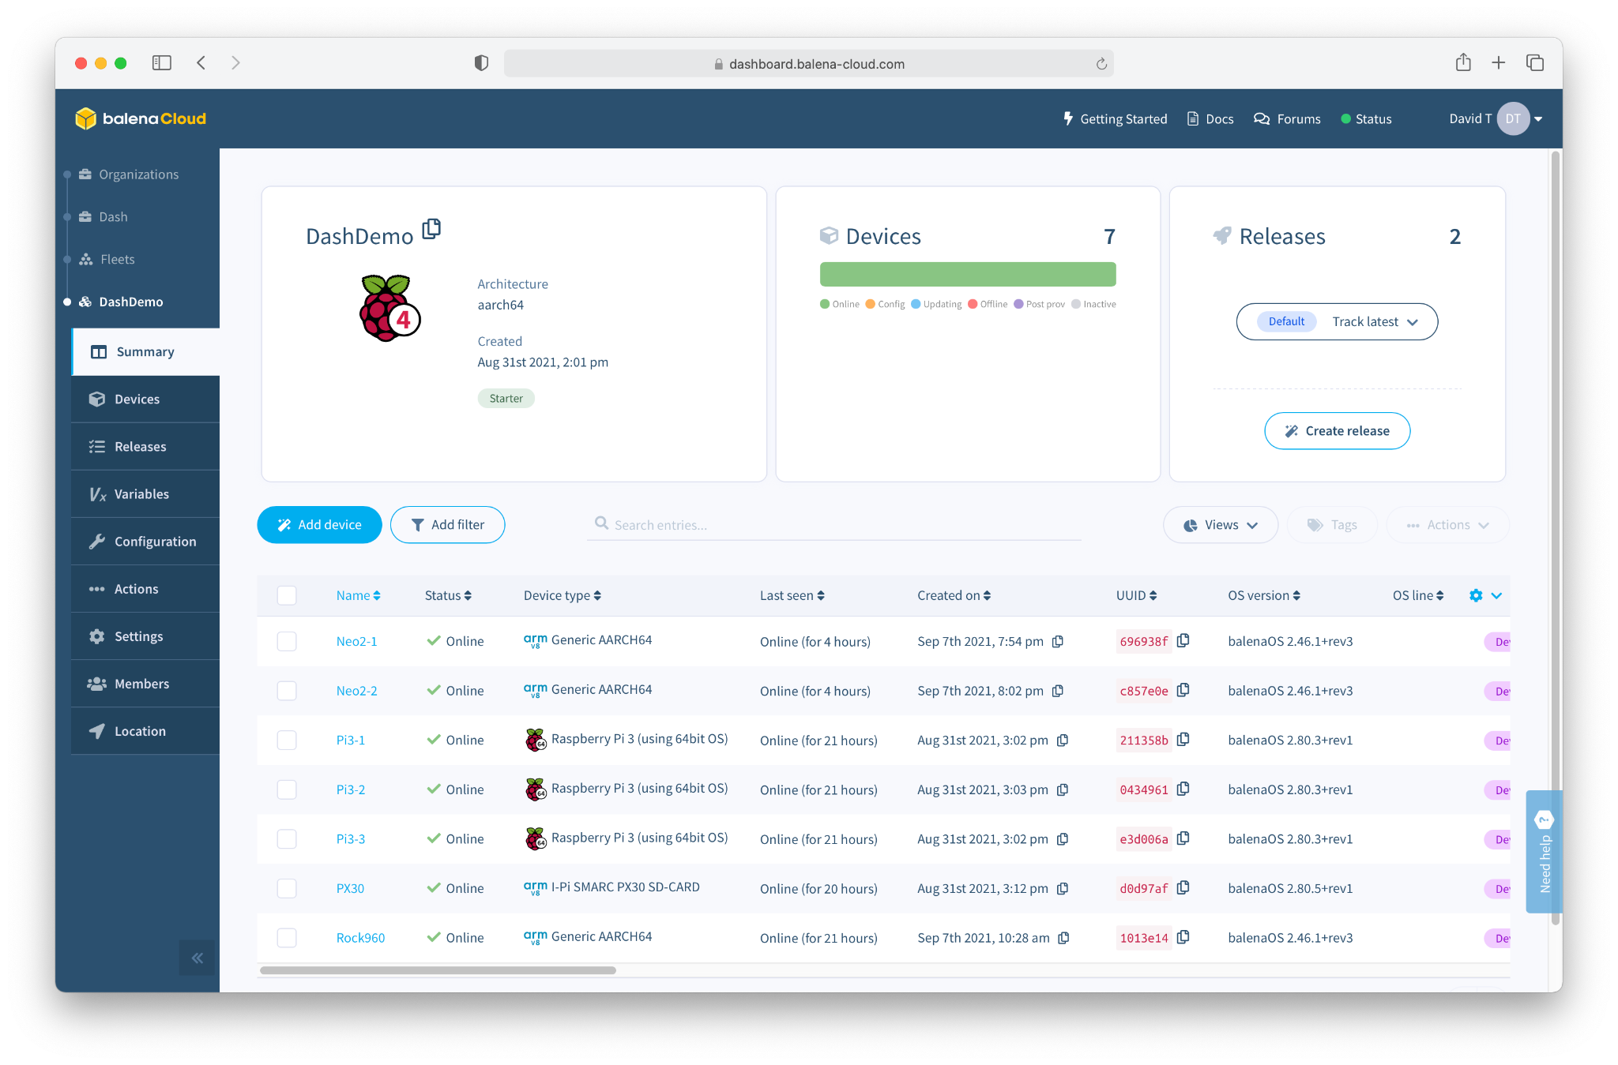
Software
balenaCloud
“Platform built to develop, deploy, and manage fleets of connected devices at scale.”

Slide 6
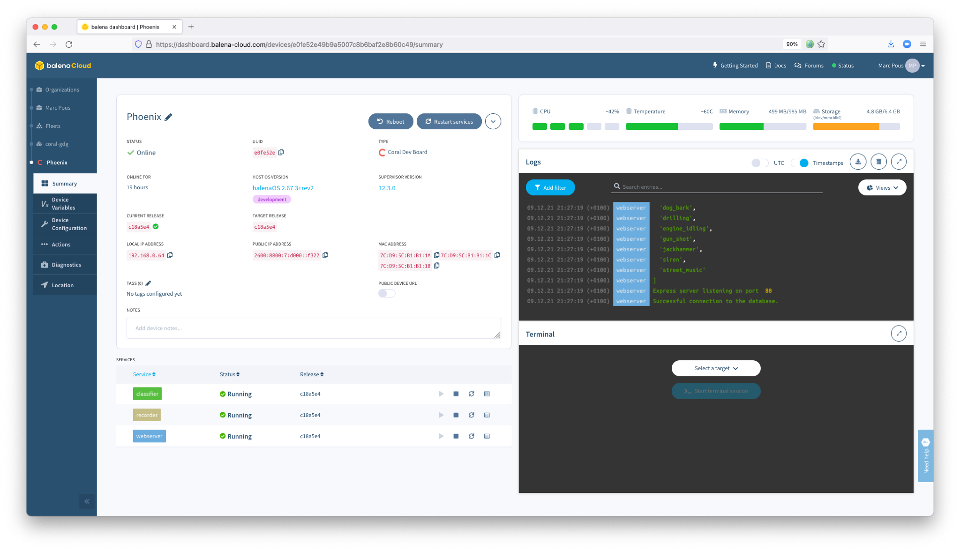

Slide 7
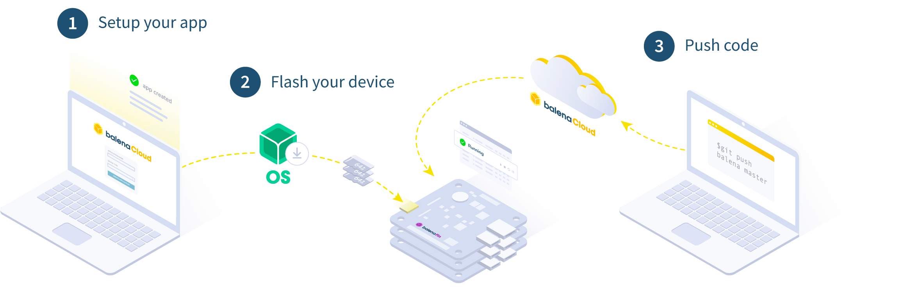
How it works

Slide 8
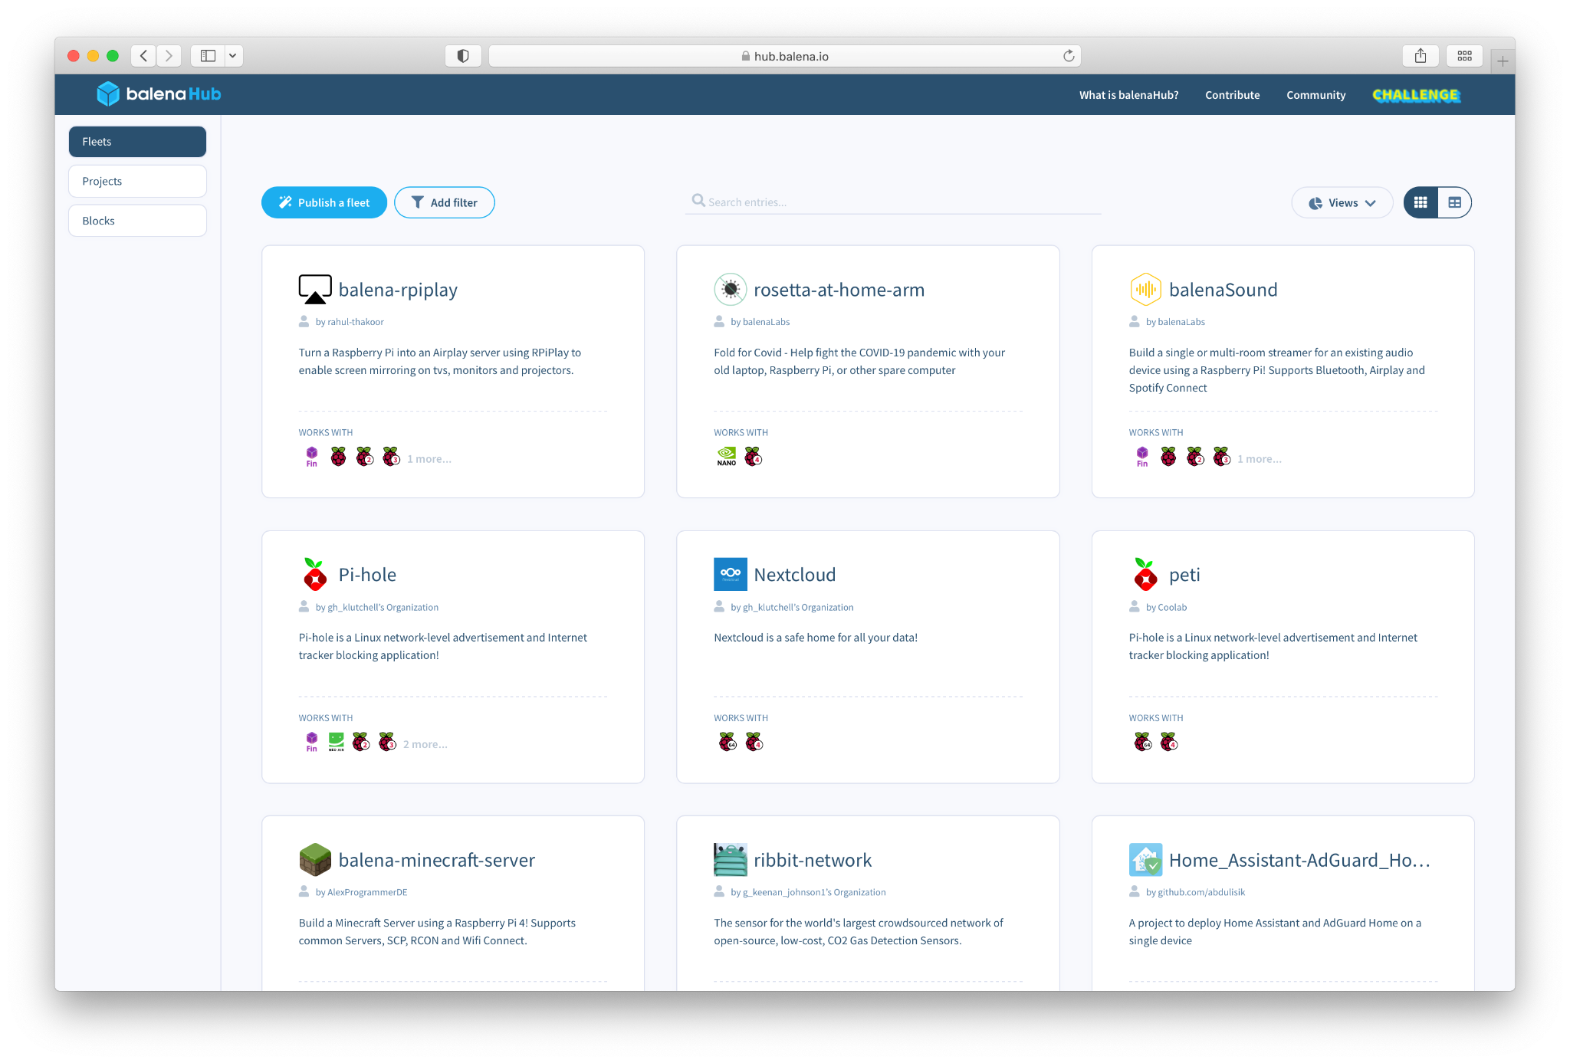
Software
balenaHub
“An easier way to find and publish fleets and projects for edge devices”

Slide 9
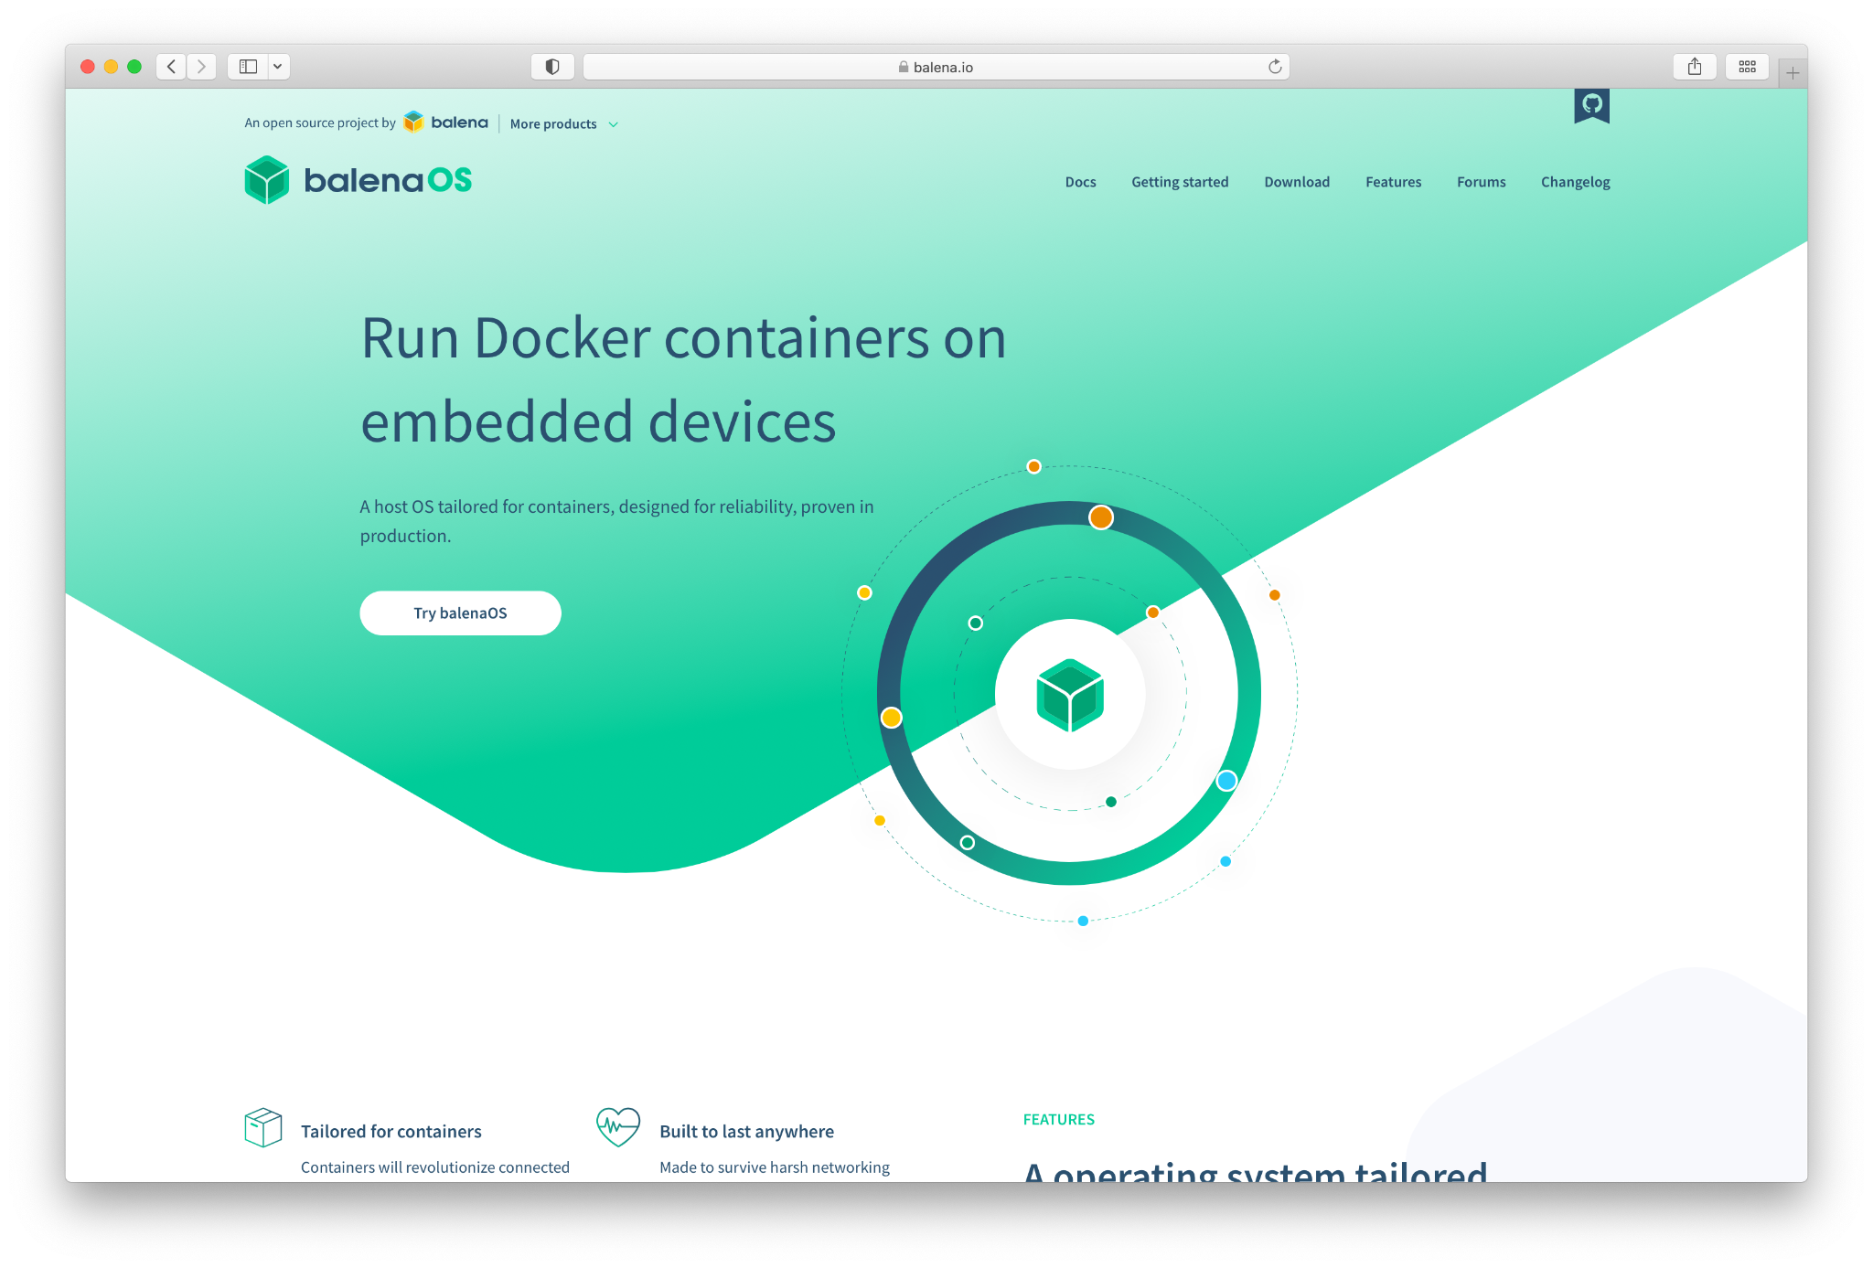
Software
Etcher
balenaEngine
Open source container runtime based upon Moby
balenaOS
Open source IoT operating system based on Yocto

Slide 10
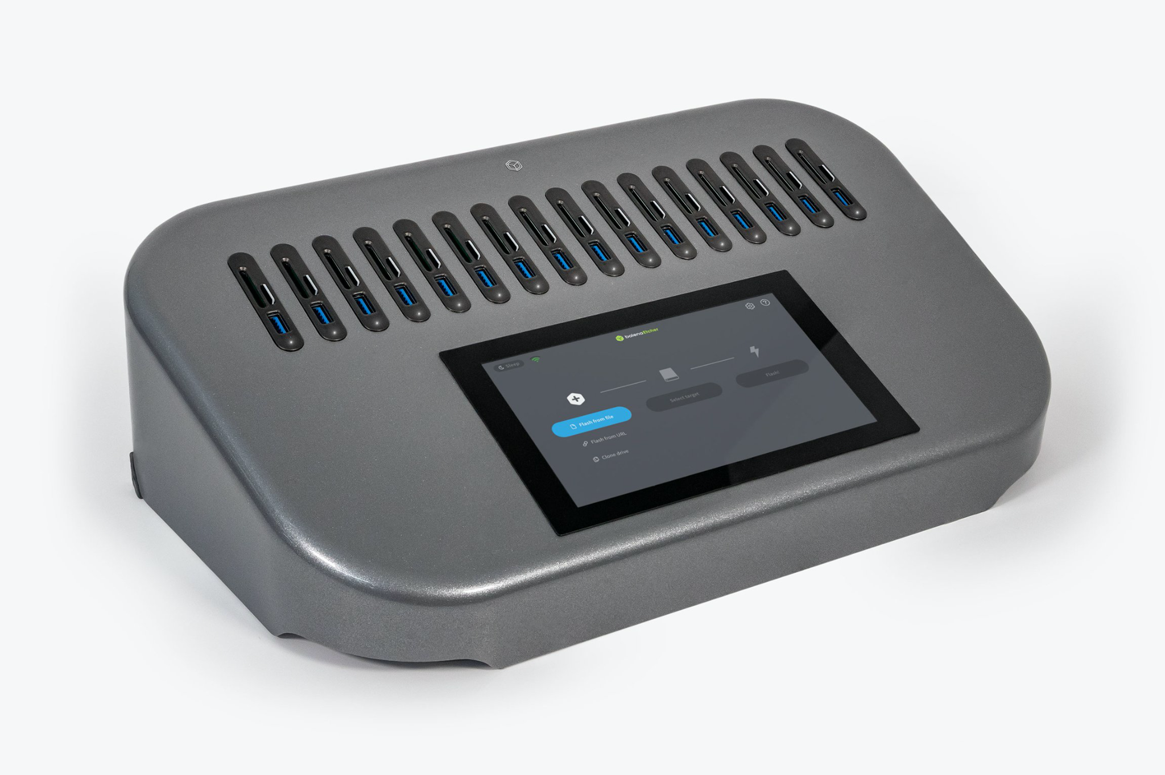
Hardware
EtcherPro
“Built to write data flawlessly to multiple devices simultaneously”

Slide 11
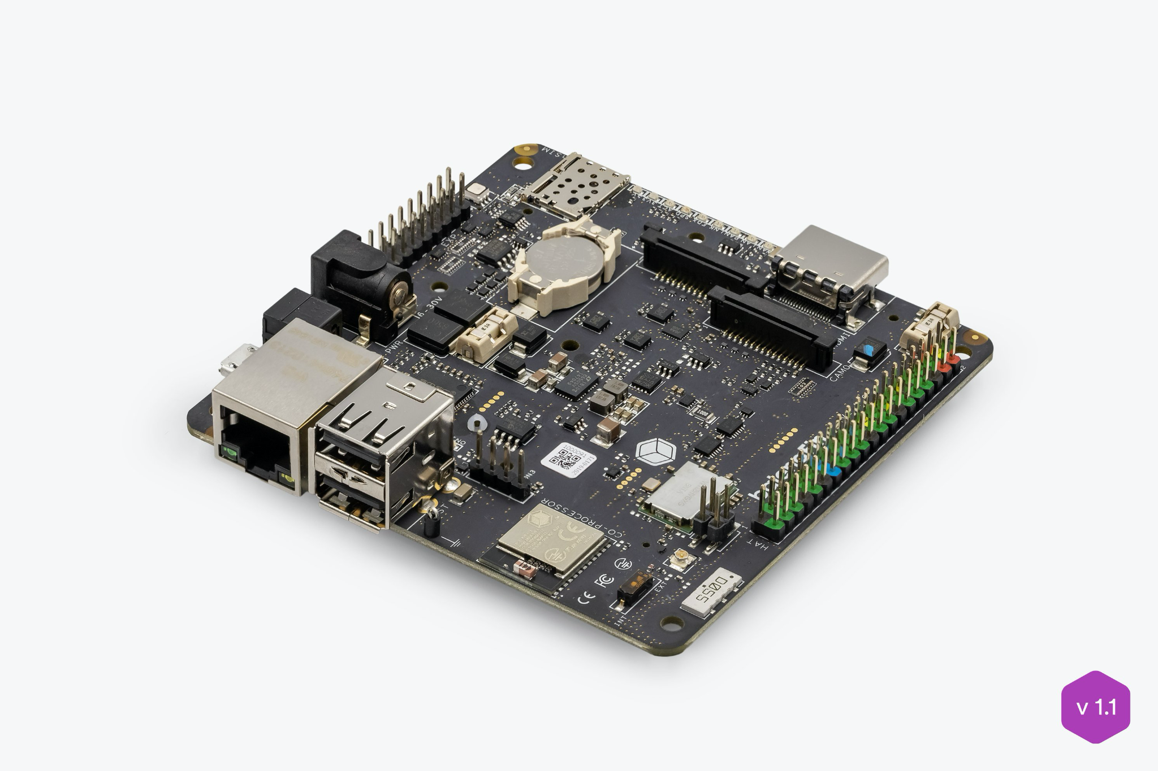
Hardware
balenaFin
“A professional carrier board for the Raspberry Pi Compute Module”

Slide 12

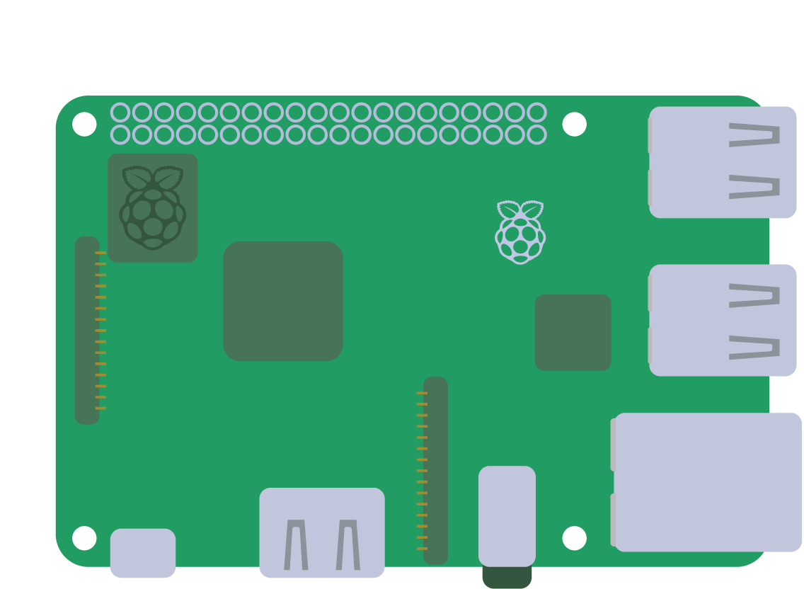




balenaLabs

Slide 13
Questions?

Slide 14
